Slide 1
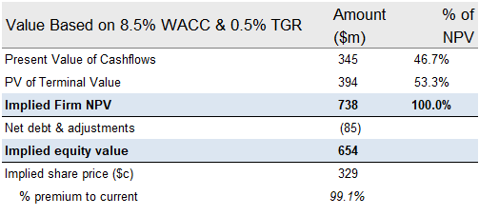
Provide an investment recommendation
Email to management
Dear Management,
I wanted to bring to your attention some critical information that has surfaced regarding the valuation of our target asset.
This morning, while reviewing the latest news, I came across a report indicating that one of WorldWide Co's competitors is contemplating a bid exceeding $650 million for the same target asset. This development introduces new dynamics that necessitate a reevaluation of our approach.
- Given the potential bid from our competitor, we must thoroughly assess the financial implications of any supply chain interruptions that might impact the target asset. Understanding and quantifying these effects are crucial for making informed decisions regarding our own bid.
- The competitive landscape has evolved, and it is imperative that we reevaluate our bidding strategy in light of the significant interest from our competitor. Understanding the dynamics of the bidding process, including potential escalation scenarios, will be vital for positioning ourselves strategically in this competitive environment.
Please find the new valuations attached below: Please respond back with any thoughts, comments and other observations you may have. Best Akshat
Net present value based on perpetuity growth method
Revised valuation (post-fire)
Preliminary valuation
Value Based on 8.5% WACC & 0.5% TGR | Amount ($m) | % of NPV
Present Value of Cash flows | 409 | 50.9%
PV of Terminal Value | 394 | 49.1%
Implied Firm NPV | 803 | 100.0%
Net debt as of Mar-20E | (85)
Implied equity value | 718
Implied offer share price (c) | 361
% premium to current | 118.8%
Source: Company Business Plan (January 2020); Equity research; J.P. Morgan analysis
1

